Slide 1
OnboardAI

Slide 2
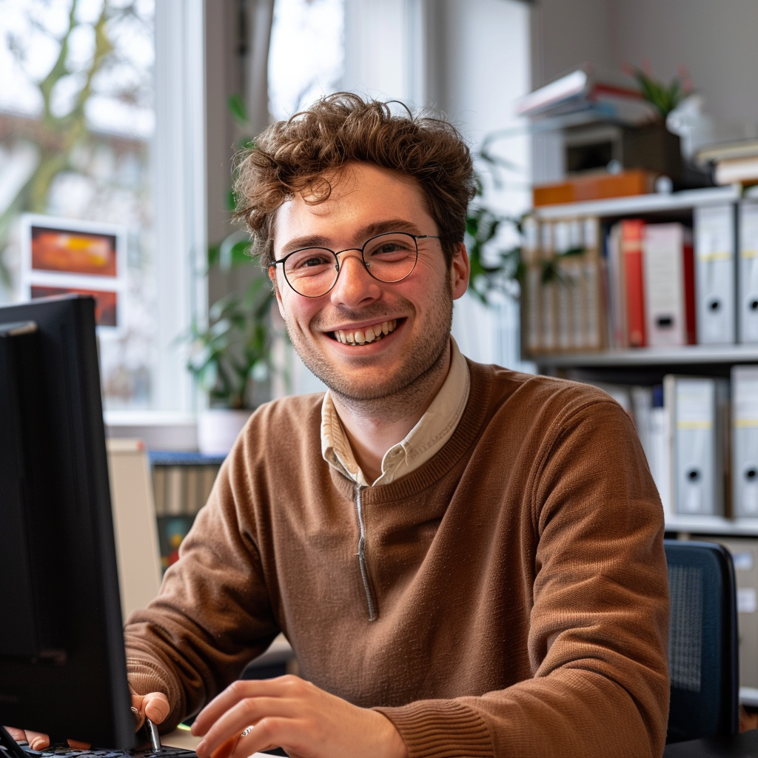
Meet Hannes
Office Worker for the University of Mannheim

Slide 3

Task: Create Onboarding
Requirements:
Use various company internal documents
Individualized for a new employee
Include History of the University of Mannheim

Slide 4
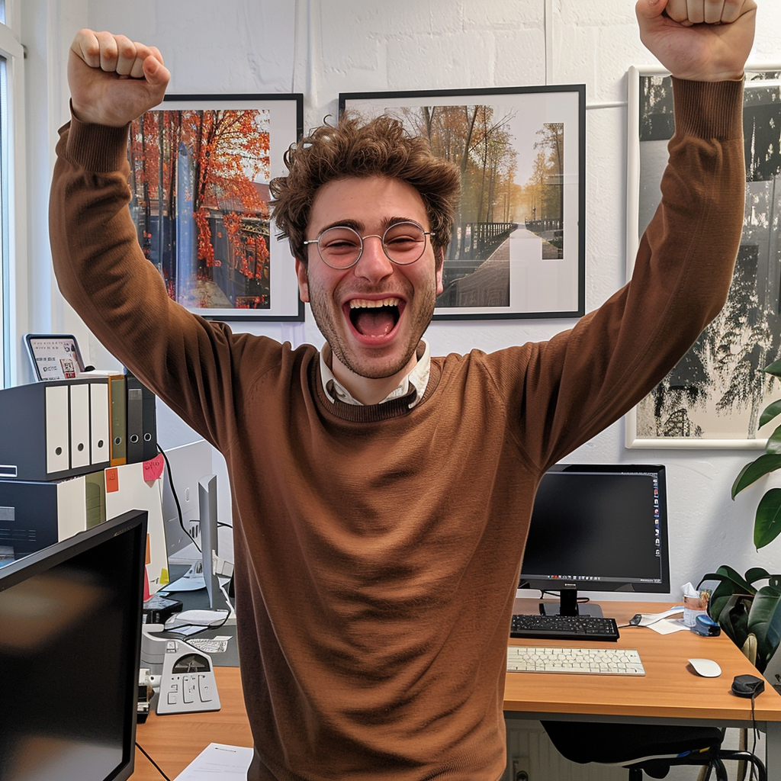
Discovers OnboardAI
Tool for generating individualized Onboardings
Automatically extract information from his documents and resources
Tailored for every employee and specific requirements

Slide 5
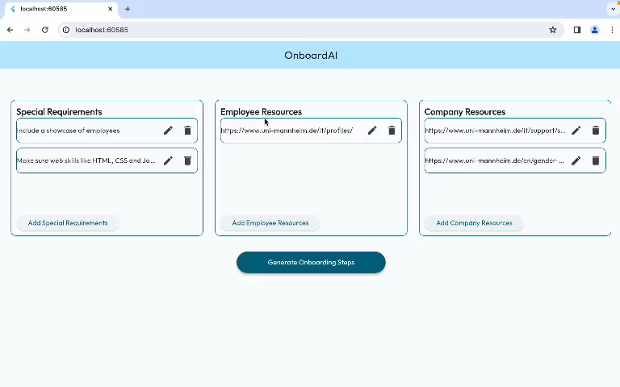
Hannes uses OnboardAI

Slide 6
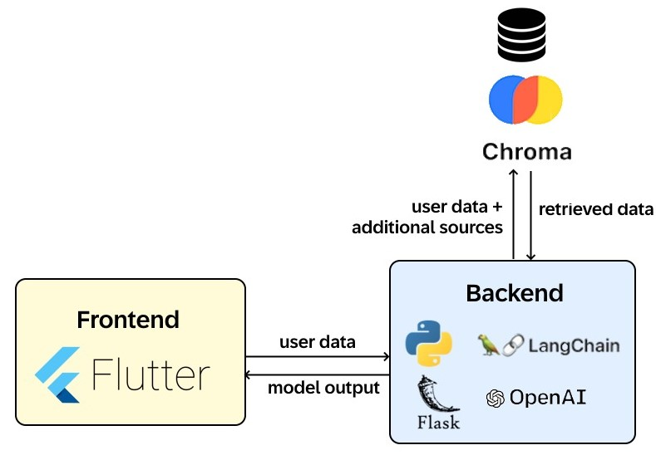
Architecture of OnboardAI

Slide 7

Conclusion & Outlook
OnboardAI helped him to create the Onboarding effortlessly
More customization options and manual editing
Generate images, graphs, videos, etc.

Slide 8

Thank you!

